Slide 1

MTE PROJECT TITLE: BATTERY MANAGEMENT SYSTEM
PRESENTED BY:
AYUSHI VERMA 2K19/EC/038
ARYAN 2K19/EC/032
SUBJECT: ANALOG ELECTRONICS-2 (EC202)
DEPARTMENT: ELECTRONICS AND COMMUNICATION ENGINEERING

Slide 2
ABSTRACT
INTRO:
Battery management systems (BMS) are electronic control circuits that monitor and regulate the charging and discharge of batteries. The battery characteristics to be monitored include the detection of battery type, voltages, temperature, capacity, state of charge, power consumption, remaining operating time, charging cycles, and some more characteristics.
CHARGE BALANCING:
In passive cell balancing, the charge from the cell having extra charge is dissipated through a load. This makes charge in in each equal. In active cell balancing, the charge is transferred from one cell to another. This makes the charge in each cell equal.

Slide 3
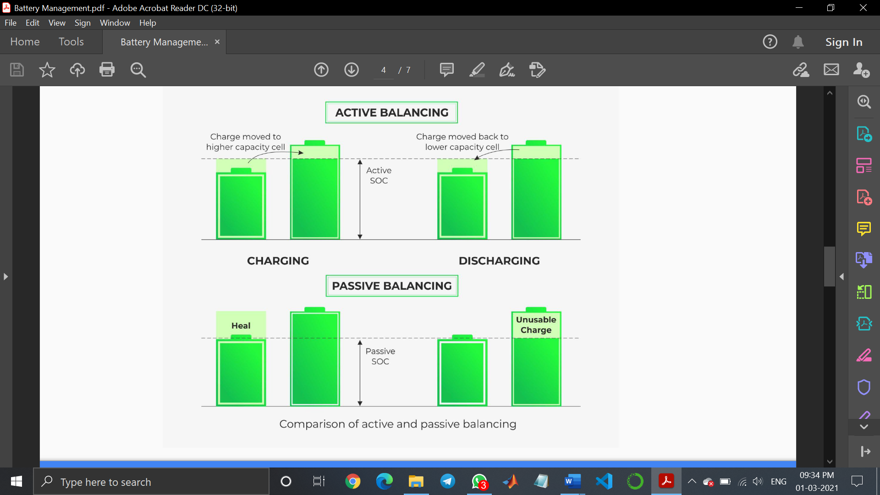
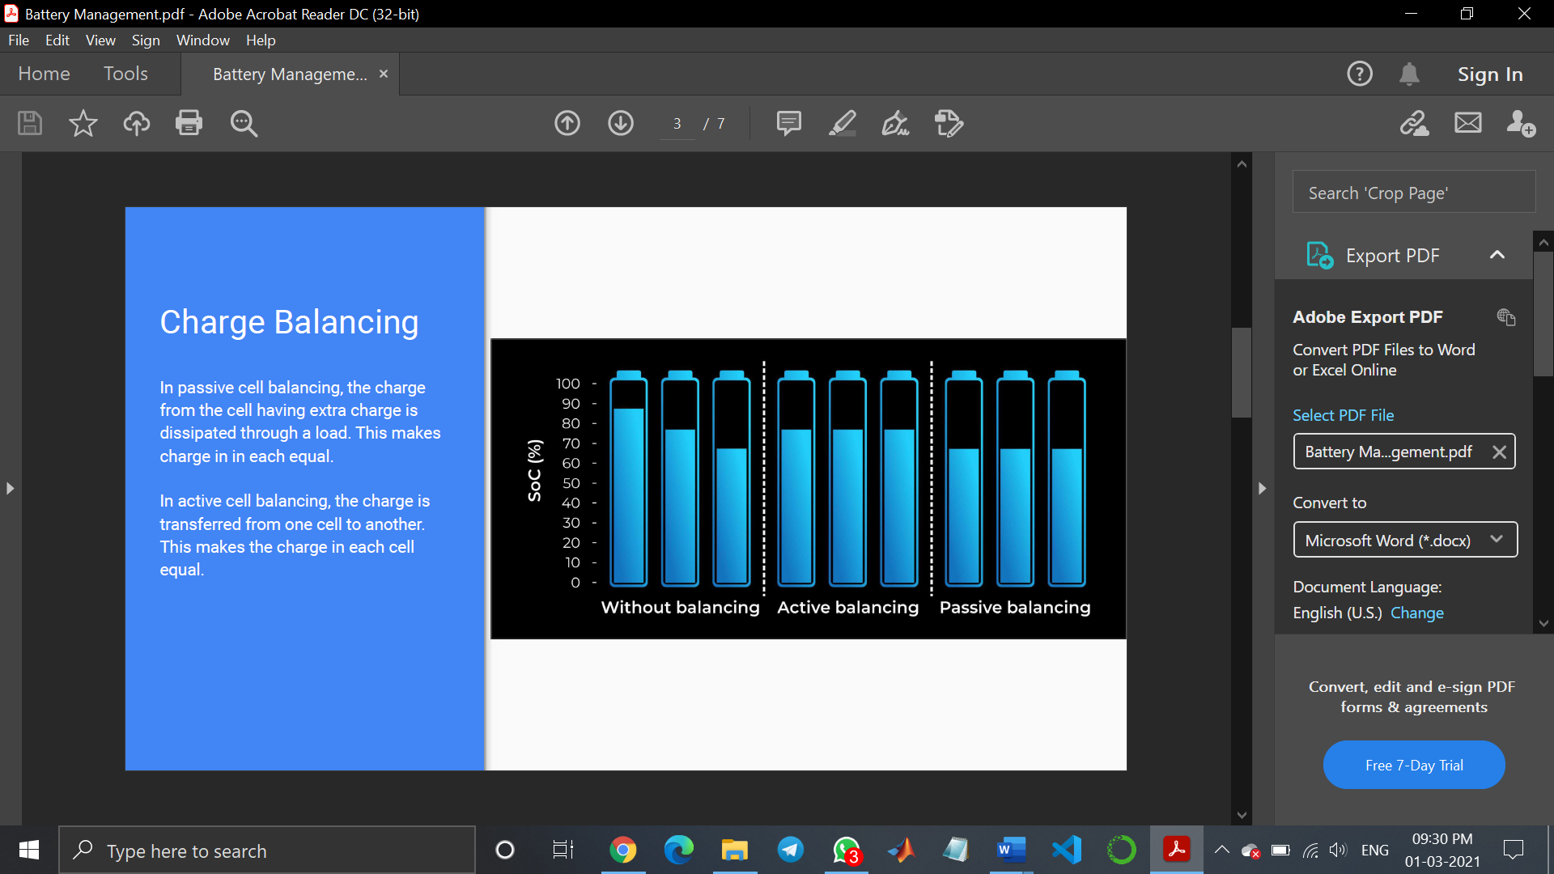
(source of pictures: https://www.ionenergy.co/resources/blogs/cell-balancing-battery-life/)

Slide 4
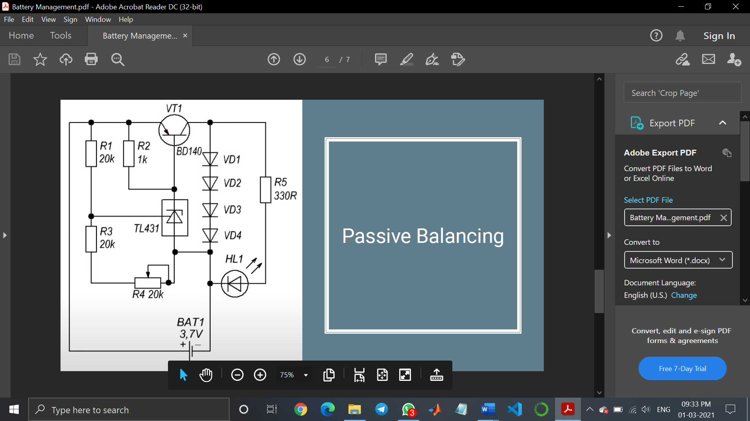
AIM
The aim of our project is to implement passive balancing method of charge balancing where we have self- defined a threshold value for the battery as 4.2V, and calculated the values of resistors required to be implemented in the circuit for effectively balancing the threshold value. The following circuit has been provided for reference, and has been taken from a research paper whose details are mentioned in bibliography.
We have verified the readings from proteus simulation and implemented the circuit on hardware.

Slide 5
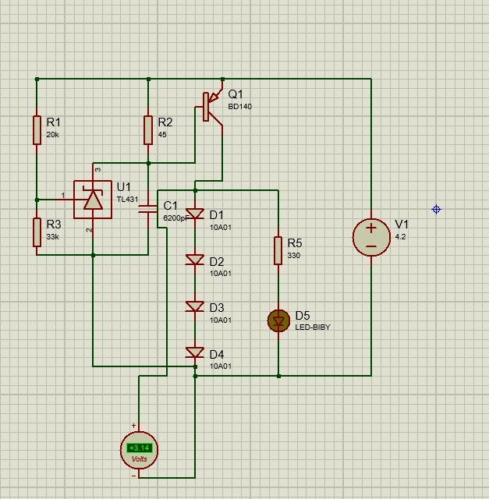
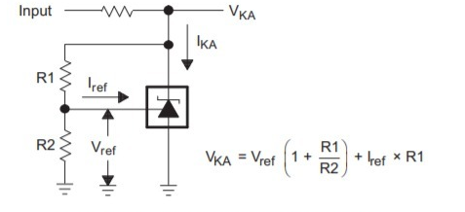
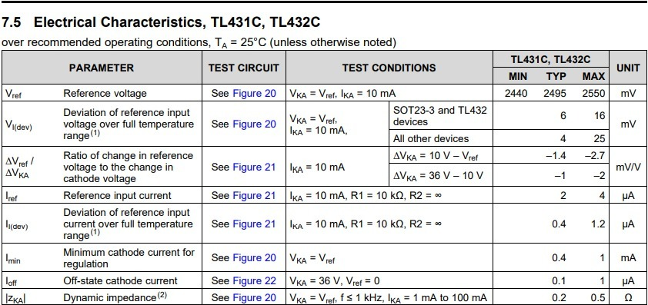
ACTUAL CIRCUIT USED IN HARDWARE PROJECT (SIMULATED ON PROTEUS):
Source: Datasheet of TL431 [4]

Slide 6
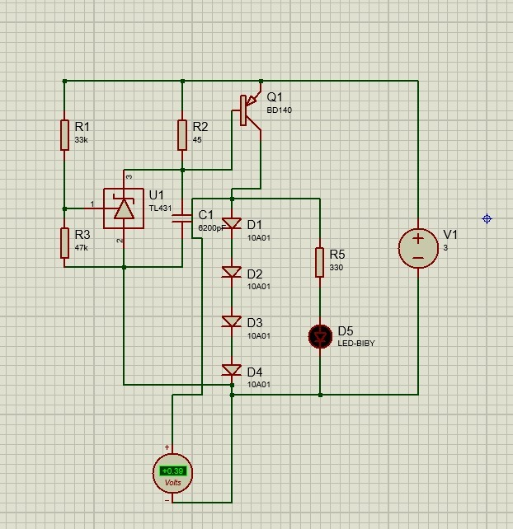
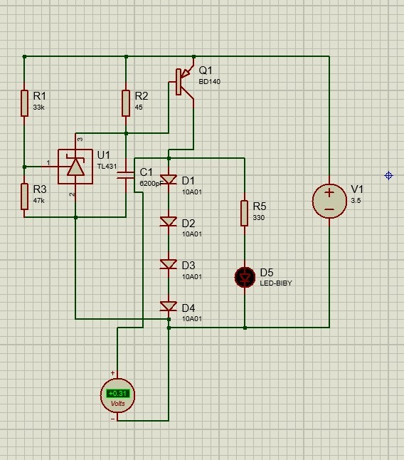
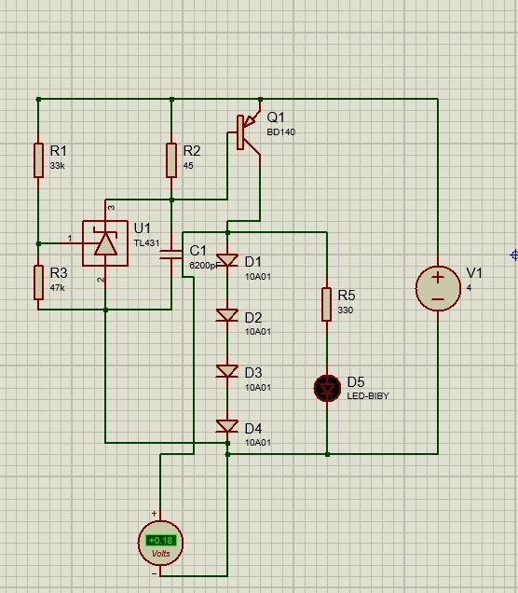
SIMULATION RESULTS:
BELOW THE THRESHOLD OF 4.2V

Slide 7
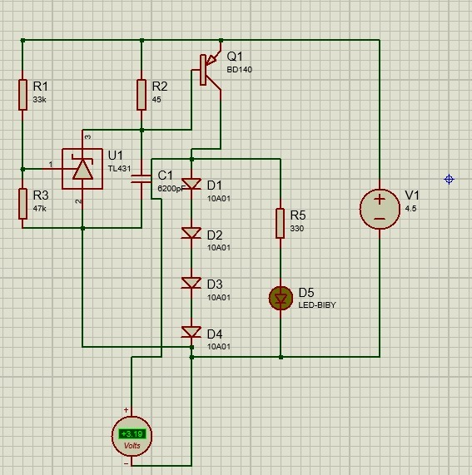
SIMULATION RESULTS:
ABOVE THE THRESHOLD OF 4.2V

Slide 8
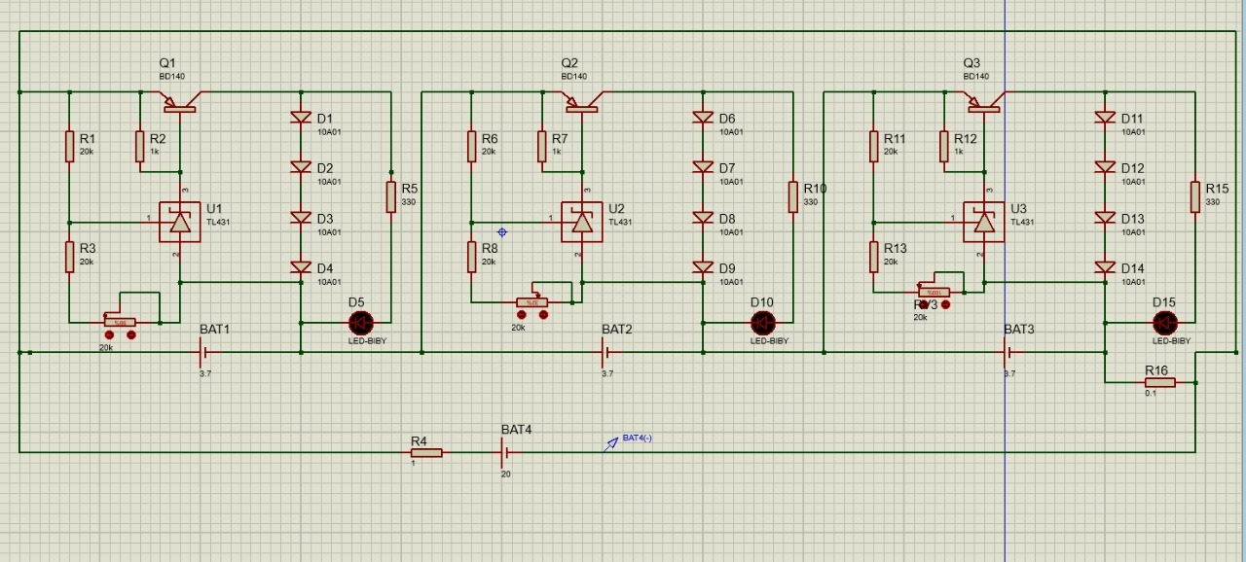
BATTERY MANAGEMENT CIRCUIT EXTENDED FOR 3 CELLS SYSTEM:

Slide 9
COMPONENTS USED IN HARDWARE IMPLEMENTATION:
1 BD140 BJT Transistor
1 TL431 Zener diode
4 PN junction diodes (10A01)
20k ohm resistor
33k ohm resistor
4.2V voltage source

Slide 10
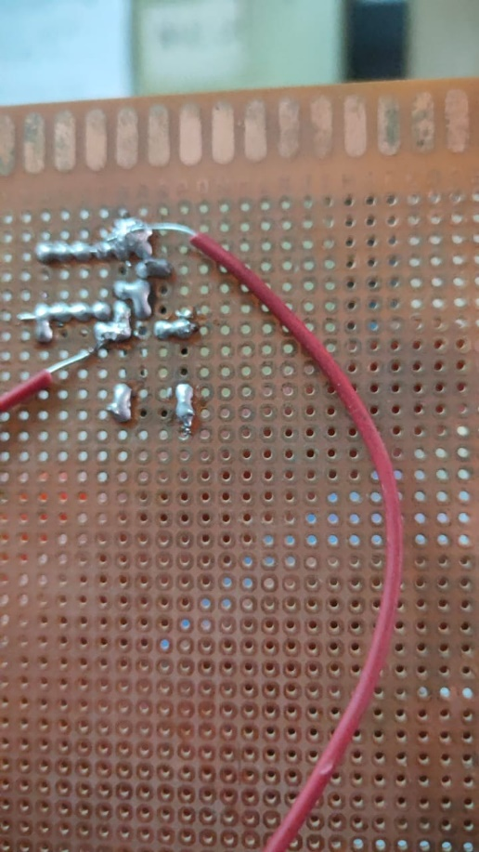
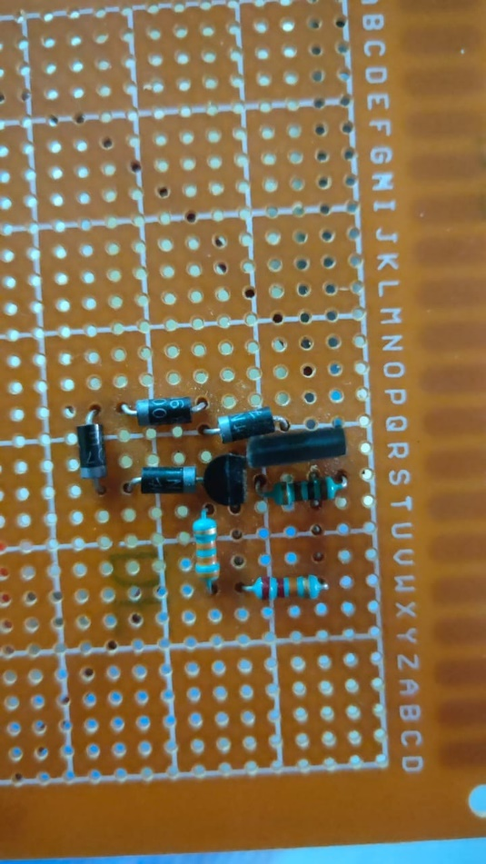
HARDWARE PHOTOS
Circuit soldered on general purpose PCB

Slide 11
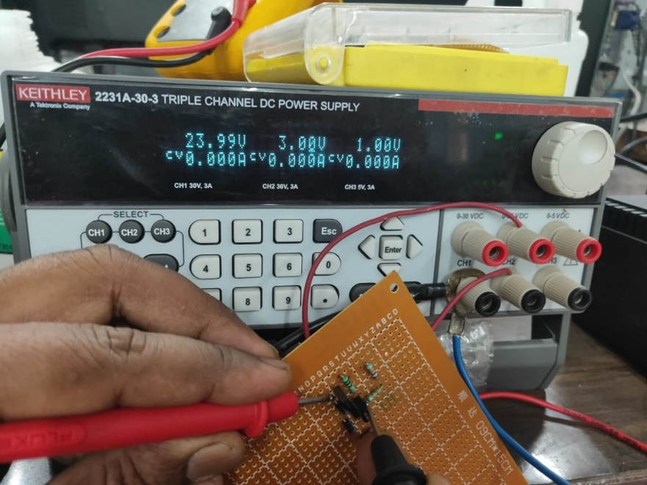
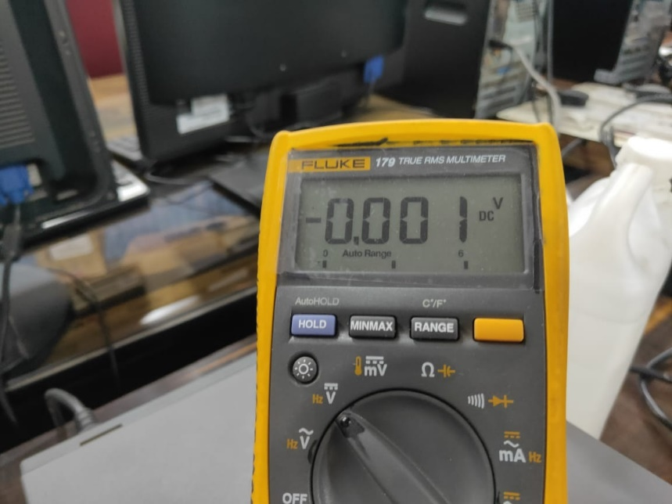
Here, when the charging voltage is 3volts (lesser than the threshold), the reading of voltage across the diodes is obtained as 0.001 Volts.

Slide 12
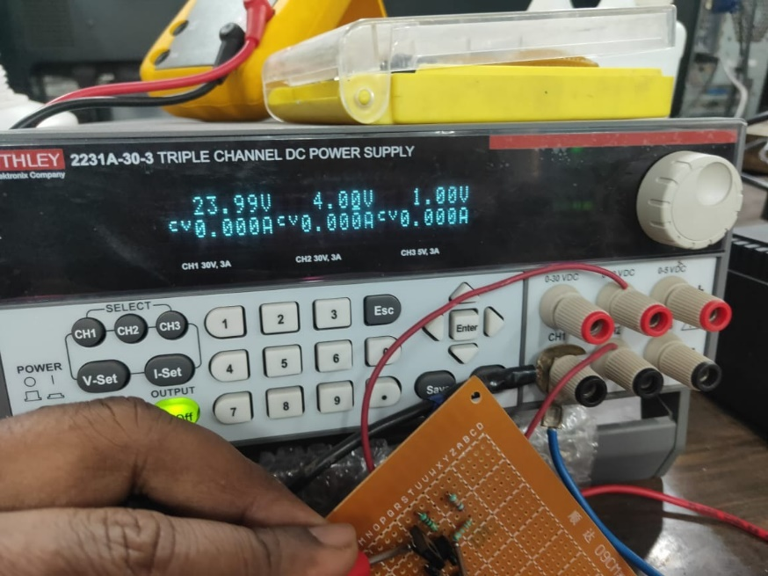
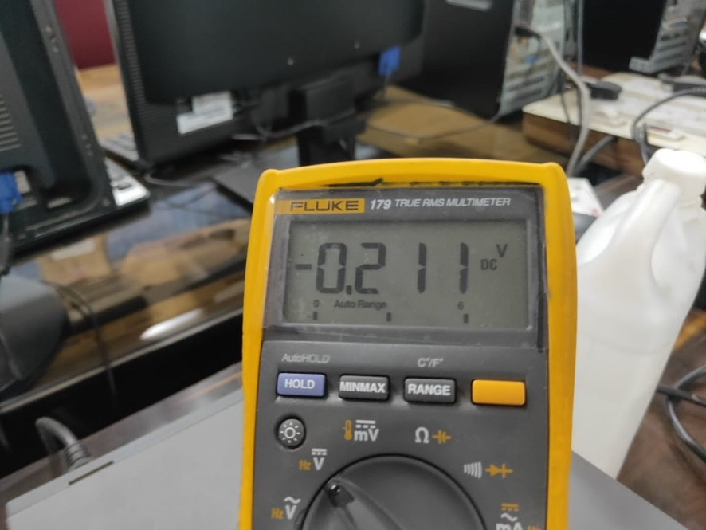
Here, when the charging voltage is 4 volts (lesser than the threshold), the reading of voltage across the diodes is obtained as 0.211 Volts.

Slide 13
VIDEO LINK FOR HARDWARE RESULTS:
https://drive.google.com/folderview?id=1hkGTQ5zAzphzq8UMaqE4VGzngMvmNDo7

Slide 14
DIFFICULTIES ENCOUNTERED, AND SOURCES OF ERRORS:
Arrangement of a function generator: Since this is an instrument which can be found in laboratories and can’t be arranged at home, but was needed for this project to generate variable voltages and take readings across the diodes at different charging voltage, we had to use the laboratory facility of the university. However, this was done when COVID-19 cases were low, and all COVID-19 guidelines were followed.
Wrong connections: Removed from testing voltages across individual components in the lab and debugging the circuit.
Damage to diodes and other components: Caution had to be taken to prevent excessive current flow across semiconductor devices which might damage them.
Errors in soldering: Since the circuit when implemented on the PCB was very small in size, care had to be taken to solder the circuit correctly, otherwise the circuit would have been short circuited.

Slide 15
CONCLUSION:
We’ve successfully implemented battery management and protection system with a threshold value of 4.2V, which we verified by applying different charging voltages and checking if the extra charge is dissipating in the loads(diodes) when the charging potential exceeds the safe threshold value for the battery. This is verified both in Proteus simulations and hardware implementations whose results are mentioned as above.
This project can be implemented in real life applications to protect batteries from overcharging like in mobile phones and laptops, and thus improves the battery life and efficiency. This can also be extended to any number of cells and to any threshold value depending on the battery system for which we are implementing the circuit.

Slide 16
References…
Michael, R. P. Sujatmiko, T. Abuzairi, M. Rizkinia and T. A. Kurniawan, "Design of Overcharging Protection and Passive Balancing Circuits Using Dioda for Lithium-Ion Battery Management System," 2019 16th International Conference on Quality in Research (QIR): International Symposium on Electrical and Computer Engineering, Padang, Indonesia, 2019
P. Cassani, S. Williamson. “Significance of Battery Cell Equalization and Monitoring for Practical Commercialization of Plug-In Hybrid Electric Vehicles.” IEEE APEC Conference December 2008, pp. 465 – 471.
Perisoara, Lucian & Guran, Ionut & Costache, Dumitrel. (2018). A Passive Battery Management System for Fast Balancing of Four LiFePO4 Cells. 390-393. 10.1109/SIITME.2018.8599258.
Texas Instruments TL431 / TL432 "Precision Programmable Reference" SLVS543P –AUGUST 2004
Radhika,(2020, 4th March), How Does Cell Balancing Improve Battery Life, https://www.ionenergy.co/resources/blogs/cell-balancing-battery-life/
Battery balancing, https://en.wikipedia.org/wiki/Battery_balancing

